Slide 1

M A J O R - P R O J E C T ON ‘JAVA & CLOUDE’
Invoice management
System

Slide 2


Submitted by : RIPAM KUNDU 14271021001 MRITANKA DEY 14271021003 SOURADIP KUNDU 14271021024
Meghnad Saha Institute of Technology
Meghnad Saha Institute of Technology (MSIT), one of the pioneering Degree Engineering Colleges of Kolkata, is approved by AICTE and affiliated to WBUT. It began its journey on September 5, 2001

Slide 3

Project Description
Invoice Management System is a website created specifically for accessing Invoice of customers. This method the process businesses execute to invoice their clients for products and services they purchase, as well as to track invoices and make invoice payments to suppliers and vendors. In simple terms, invoice management involves dealing with both accounts receivable and accounts payable.
An invoice management system is a software application or a set of tools designed to streamline and automate the process of creating, sending, tracking, and managing invoices within an organization. It provides businesses with an efficient and organized way to handle their invoicing processes, reducing manual efforts, minimizing errors, and improving overall productivity.

Slide 4

ACKNOWLEDGEMENT
I would like to express my special thanks of gratitude to our respected teacher MR. SOUMOUYA CHAKRABORTY who gave us the golden opportunity to do this wonderful project on the topic “INVOICE MANAGEMENT SYSTEM”, which also helped us in doing a lot of research and we came to know about so many new things I am really thankful to them.
Secondly, we would also like to thank our friends who helped us a lot in finalizing this project within the limited time frame.

Slide 5

Abstract
An invoice management system aims to simplify and optimize these processes by providing a centralized platform where businesses can generate professional-looking invoices, automate recurring billing, track payment statuses, and manage customer information. It typically integrates with accounting software and other relevant systems to ensure accurate financial records and seamless data synchronization
This Invoice Management System And managing System is in HTML, JavaScript, and CSS. Talking about the features of this system, it contains the server section and the user (customer) section. All the editing, updating, managing details, order items from the admin section while customers can only go through the site and give orders if they want. The design of this system is simple so that the user won’t get any difficulties while working on it.
The system should provide options for customizing invoice templates, allowing businesses to incorporate their branding elements, such as logos and color schemes.

Slide 6

Software Requirement Specification
Software
Operating System
1. OS Windows 7,8,10 (owned)
2. Linux
3. MAC OS
Web Browser
1. Internet Explorer 7
2. Google Chrome
3. Mozilla Firefox
3. All web browser i.e. supported by JavaScript.
Hardware
1. CPU dual core
2. HDD-100 GB
3. RAM-4 GB or more

Slide 7



Project Development tools
Frontend
HTML
CSS
BootStarp
Javascript
Backend
JAVA
JSP
Servlet
JDBC
Software used
Notepad++
or
Visual Studio Code
Apache Tomcat Server
7

Slide 8

Modules
Login System.
Customer System.
Product System
Invoice System.
ONLINE FOOD ORDERING

Slide 9
Flow Chart
Start
Create Invoice
Add Product
Calculate Total
Set Due Date
Send Invoice
Received Payment
Generate Invoice
End

Slide 10
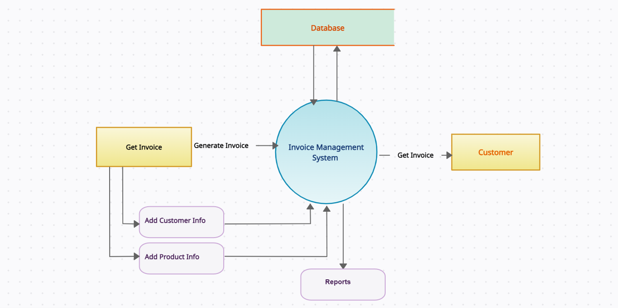
Data Flow Diagram [ DFD ]

Slide 11
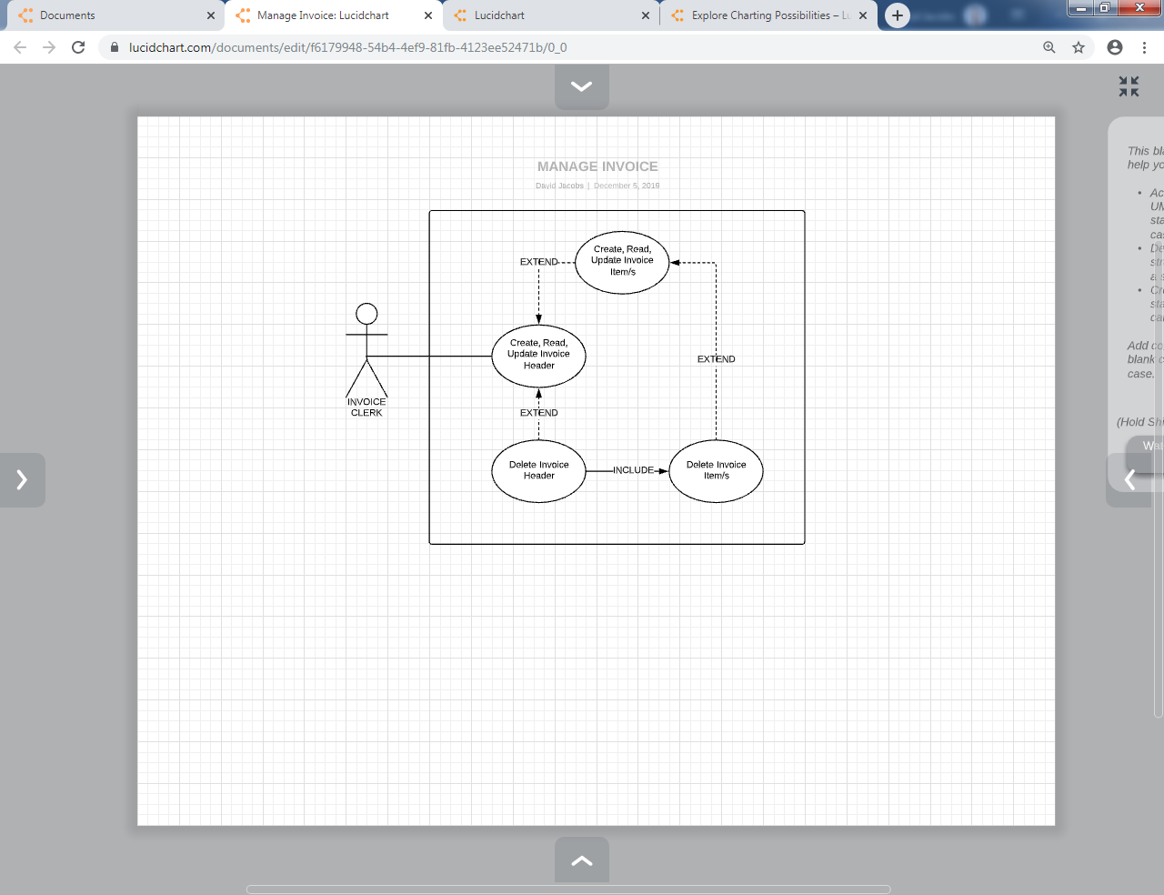
Use Case Diagram

Slide 12
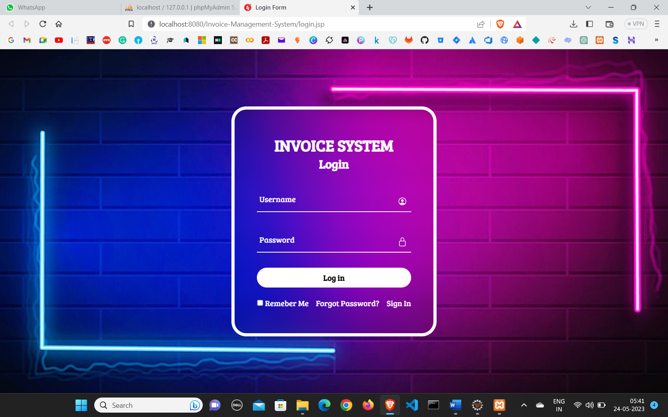
Login Page

Slide 13
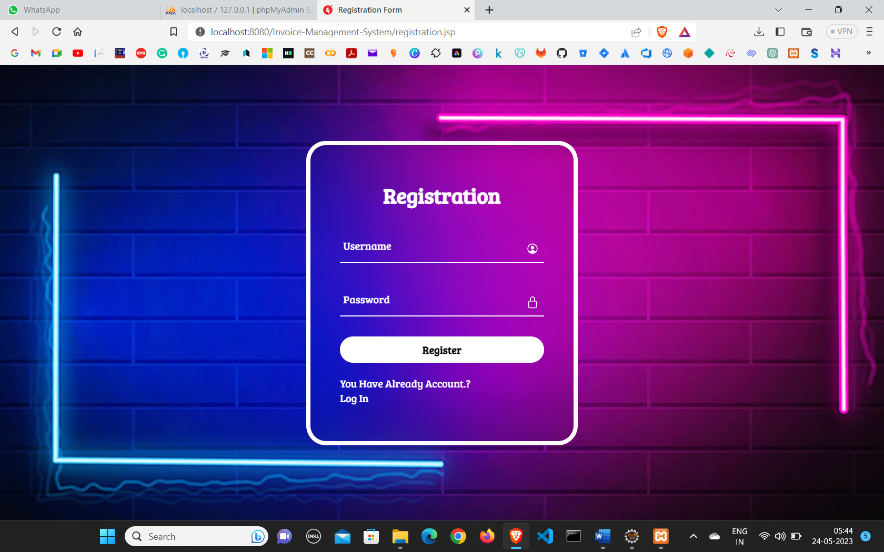
Sign in Page

Slide 14
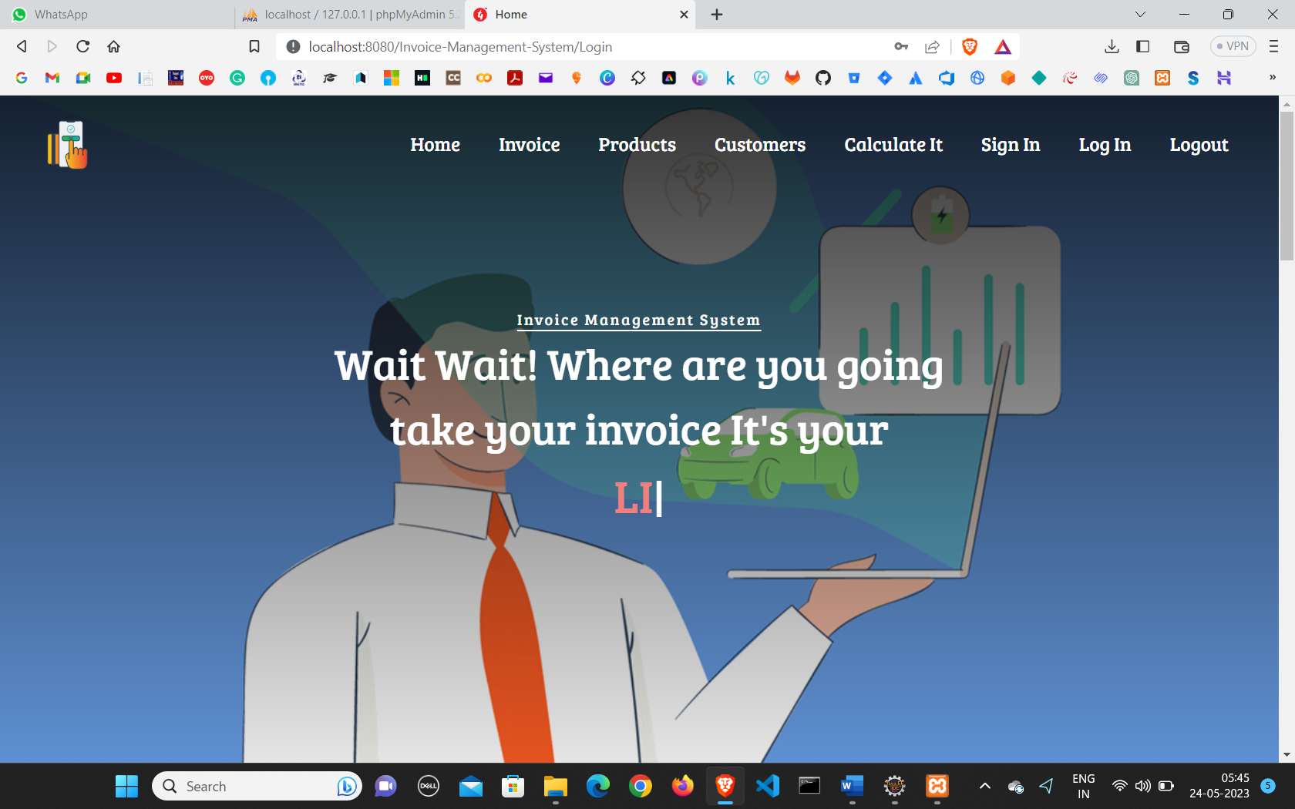
Home Page

Slide 15
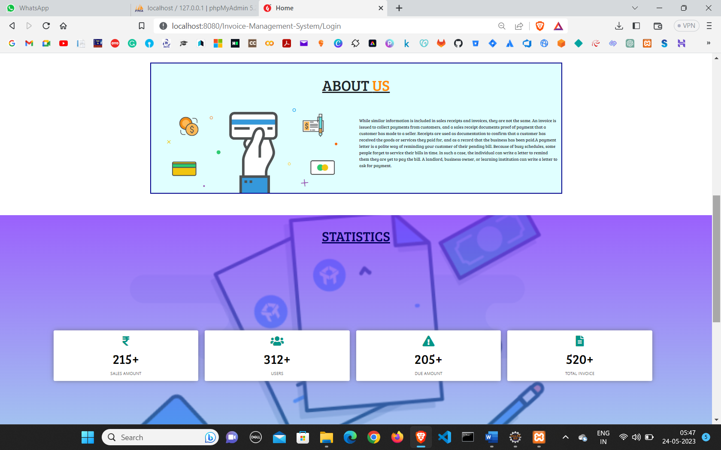
About Page

Slide 16
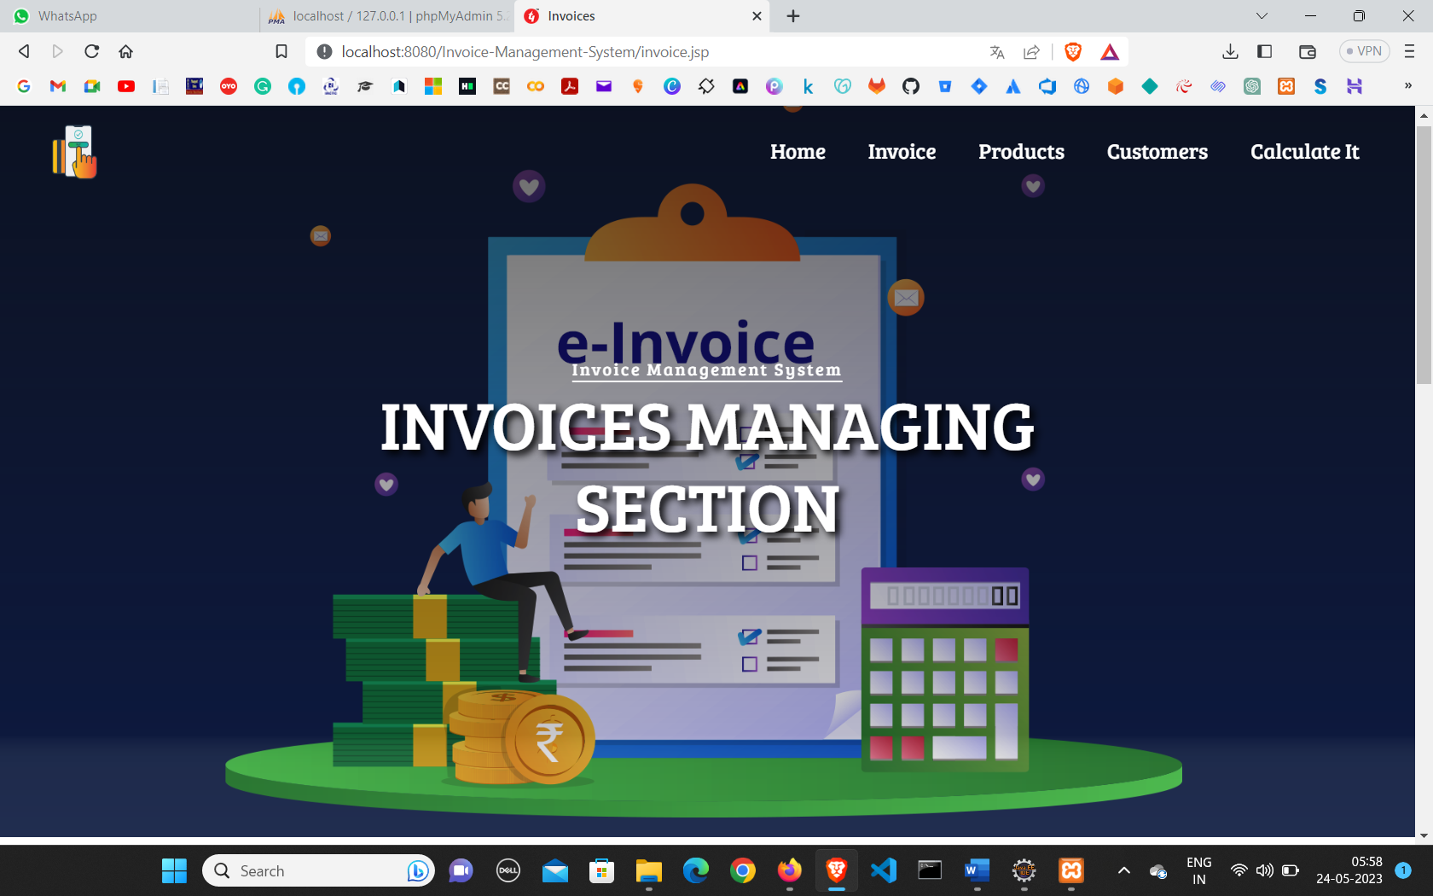
Invoice Page

Slide 17
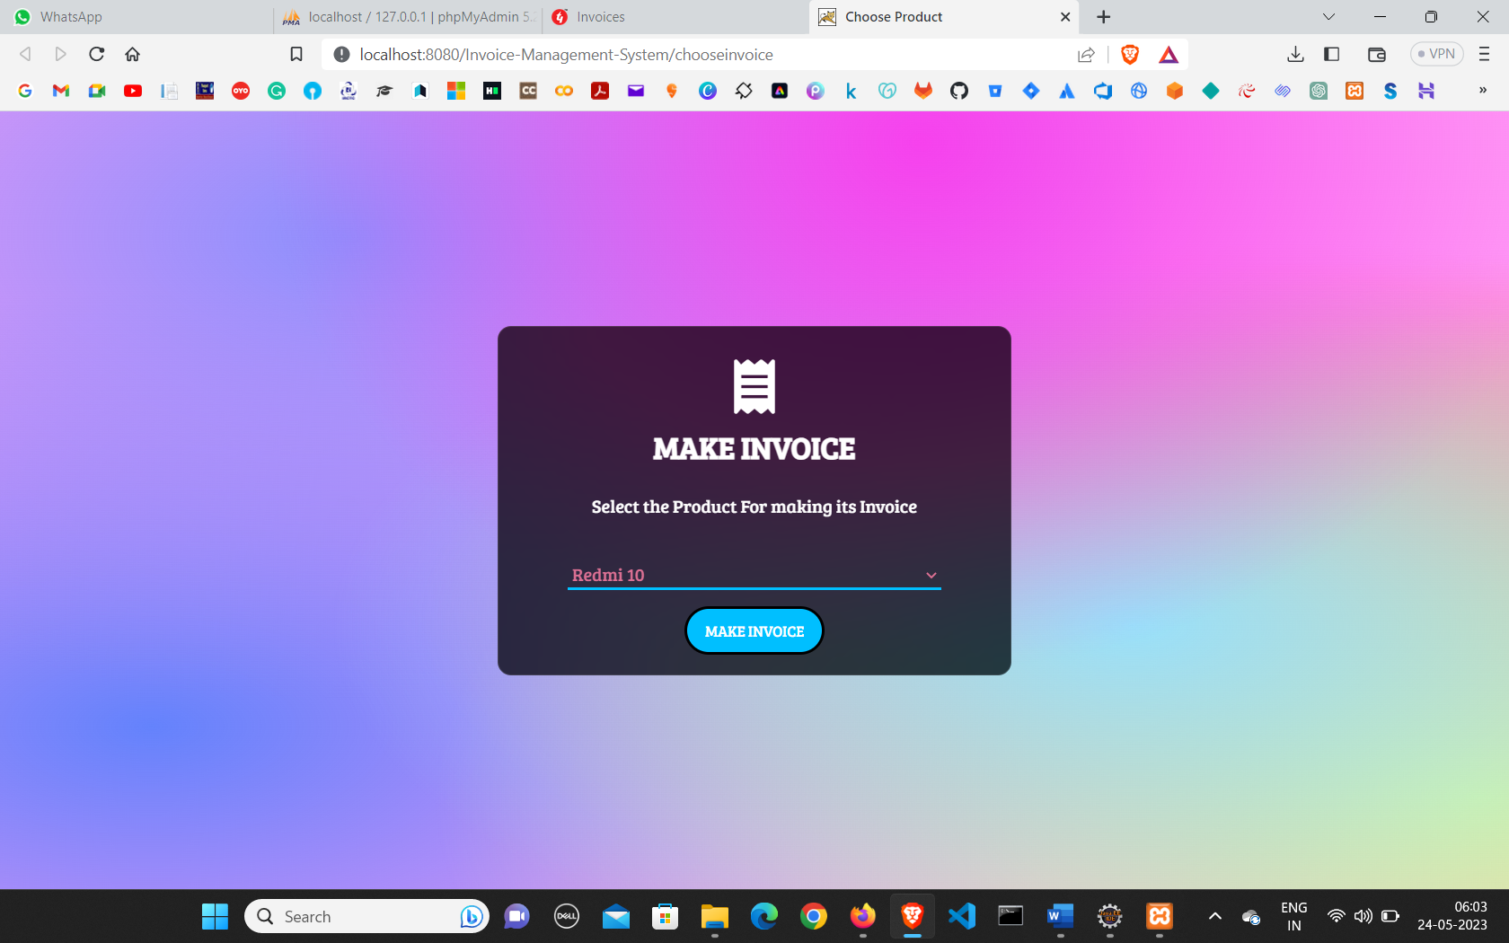
Create Invoice Page

Slide 18
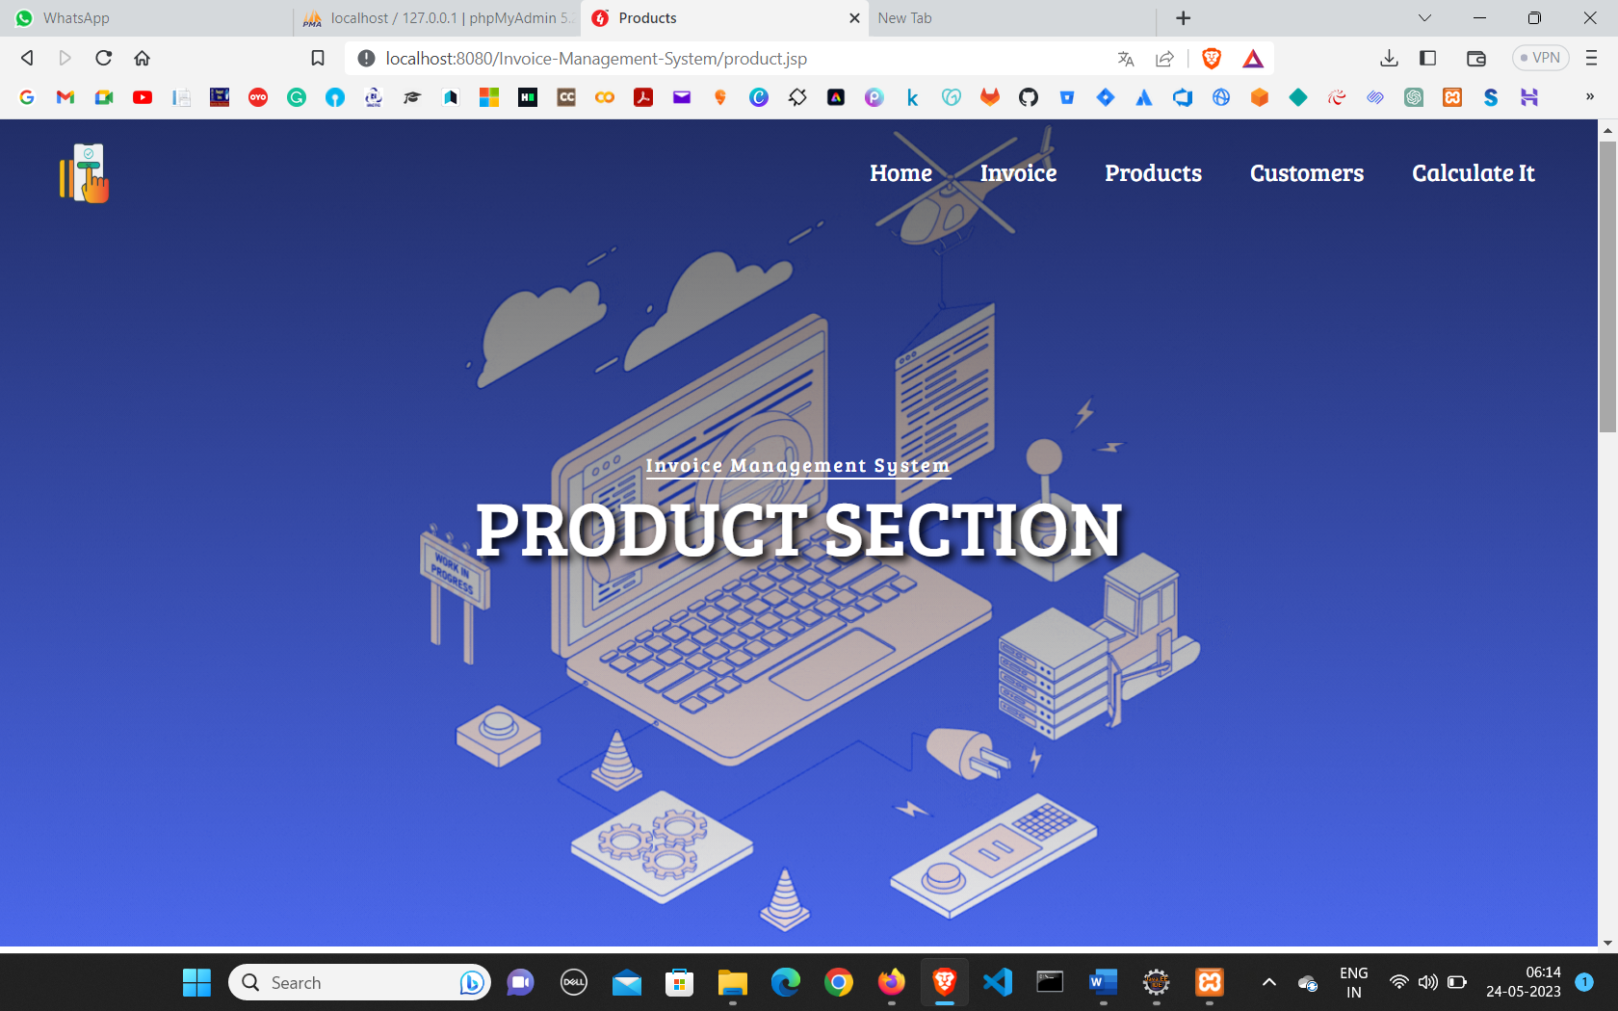
Product Page

Slide 19
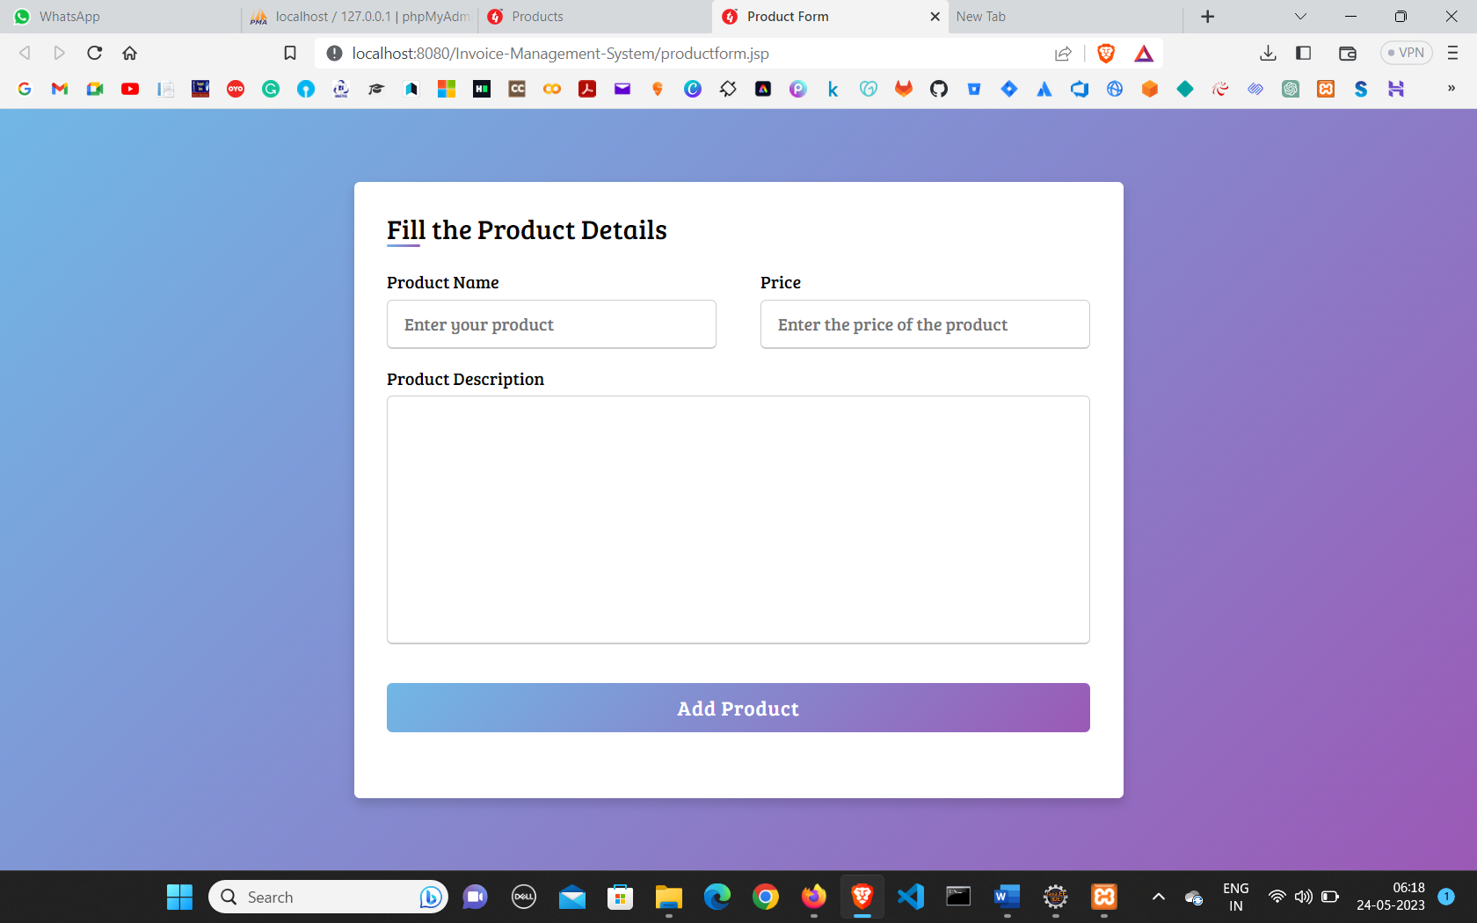
Create Product

Slide 20
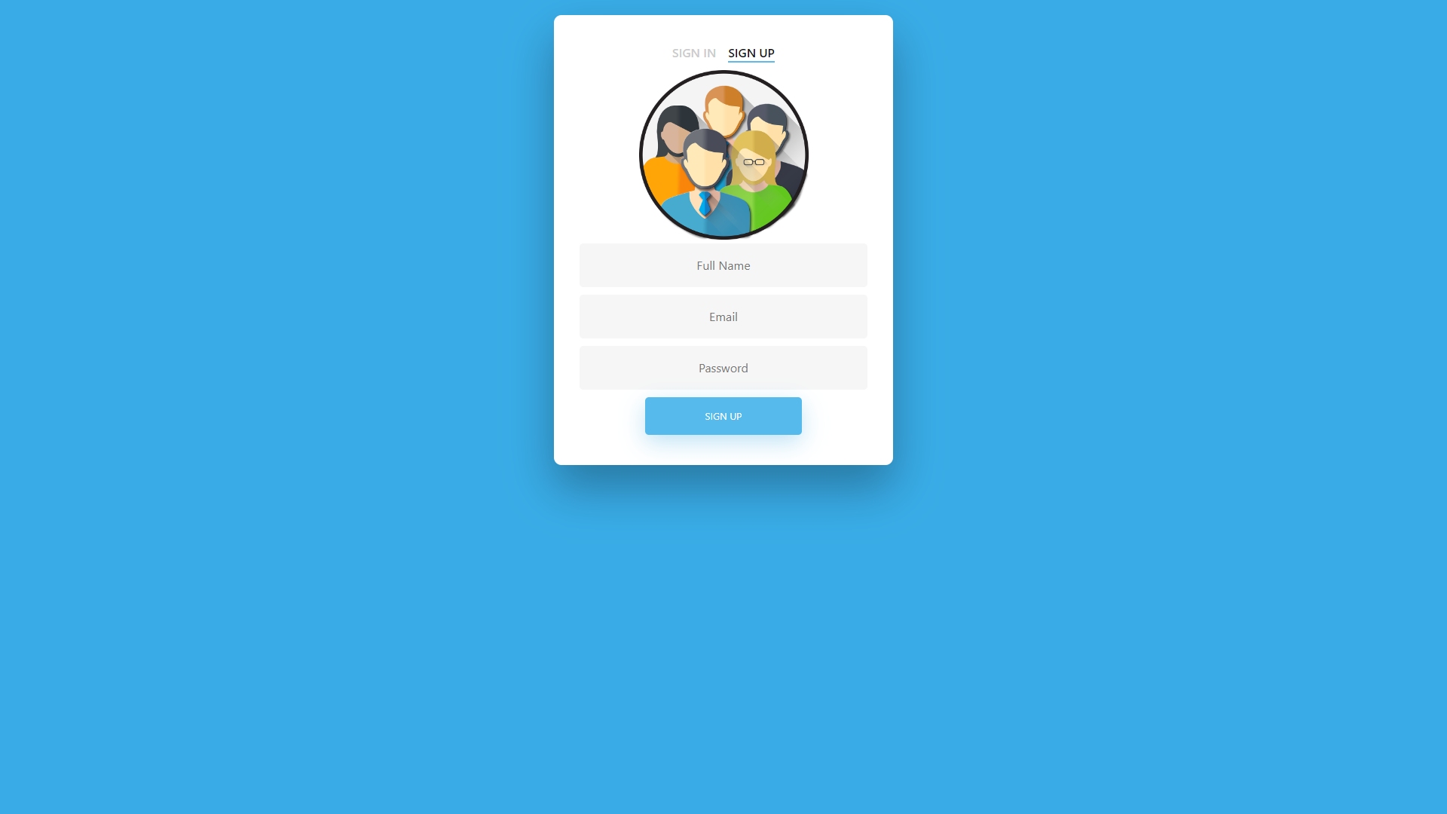
Admin:Regestration

Slide 21
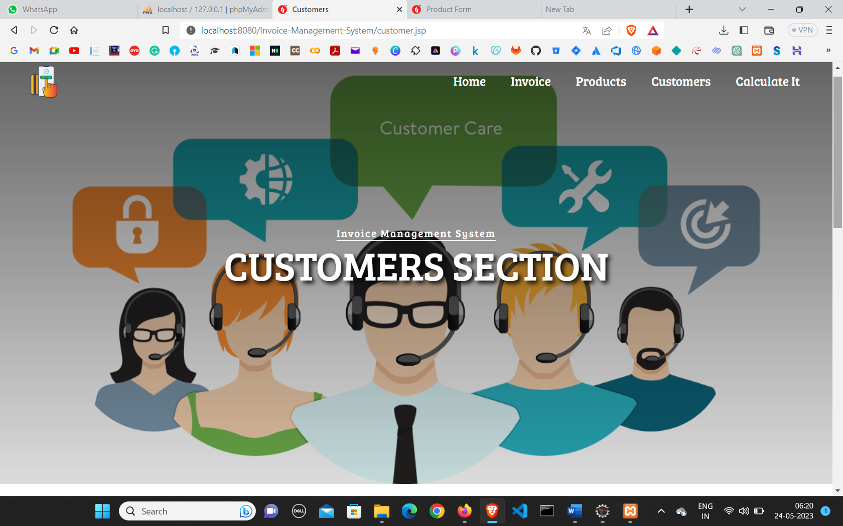
Customer Page

Slide 22
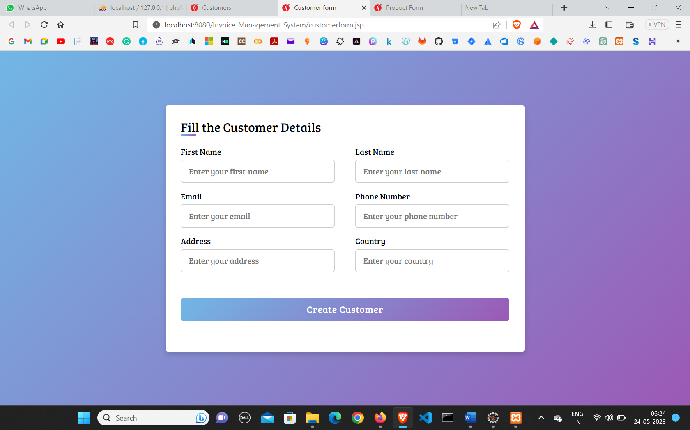
Create Customer

Slide 23
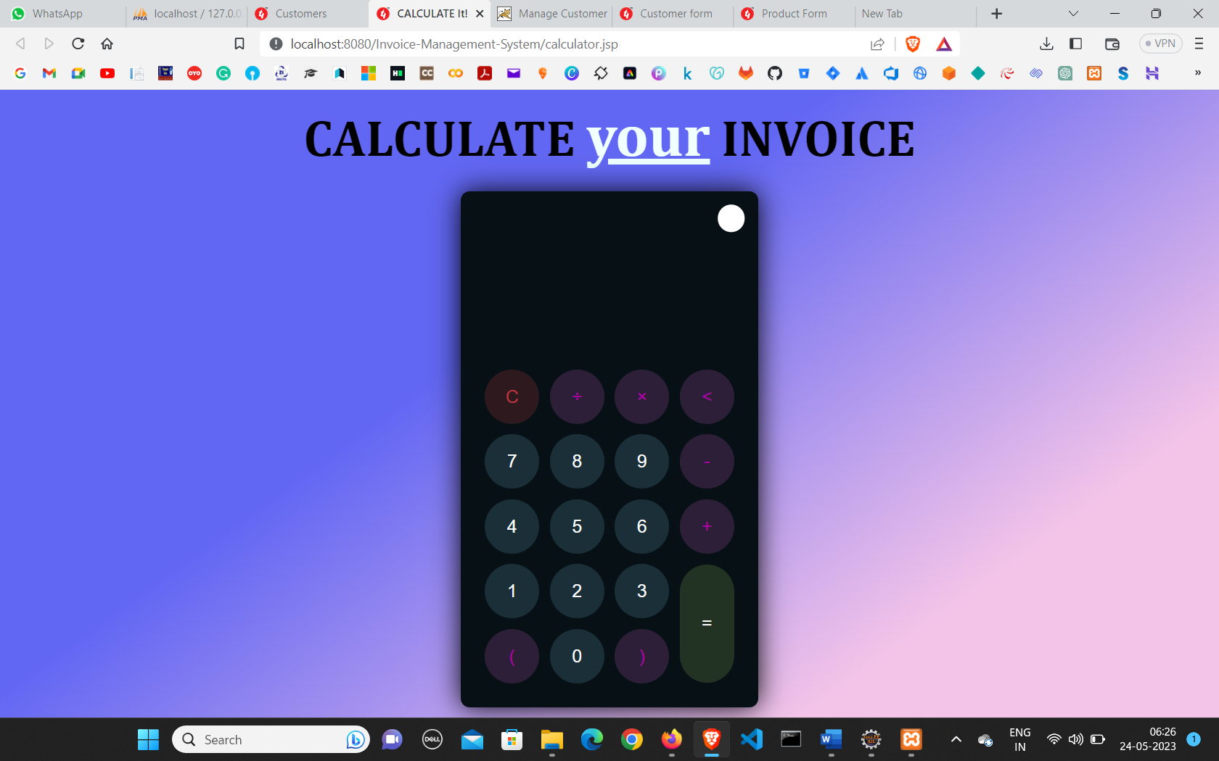
Calculate Total

Slide 24
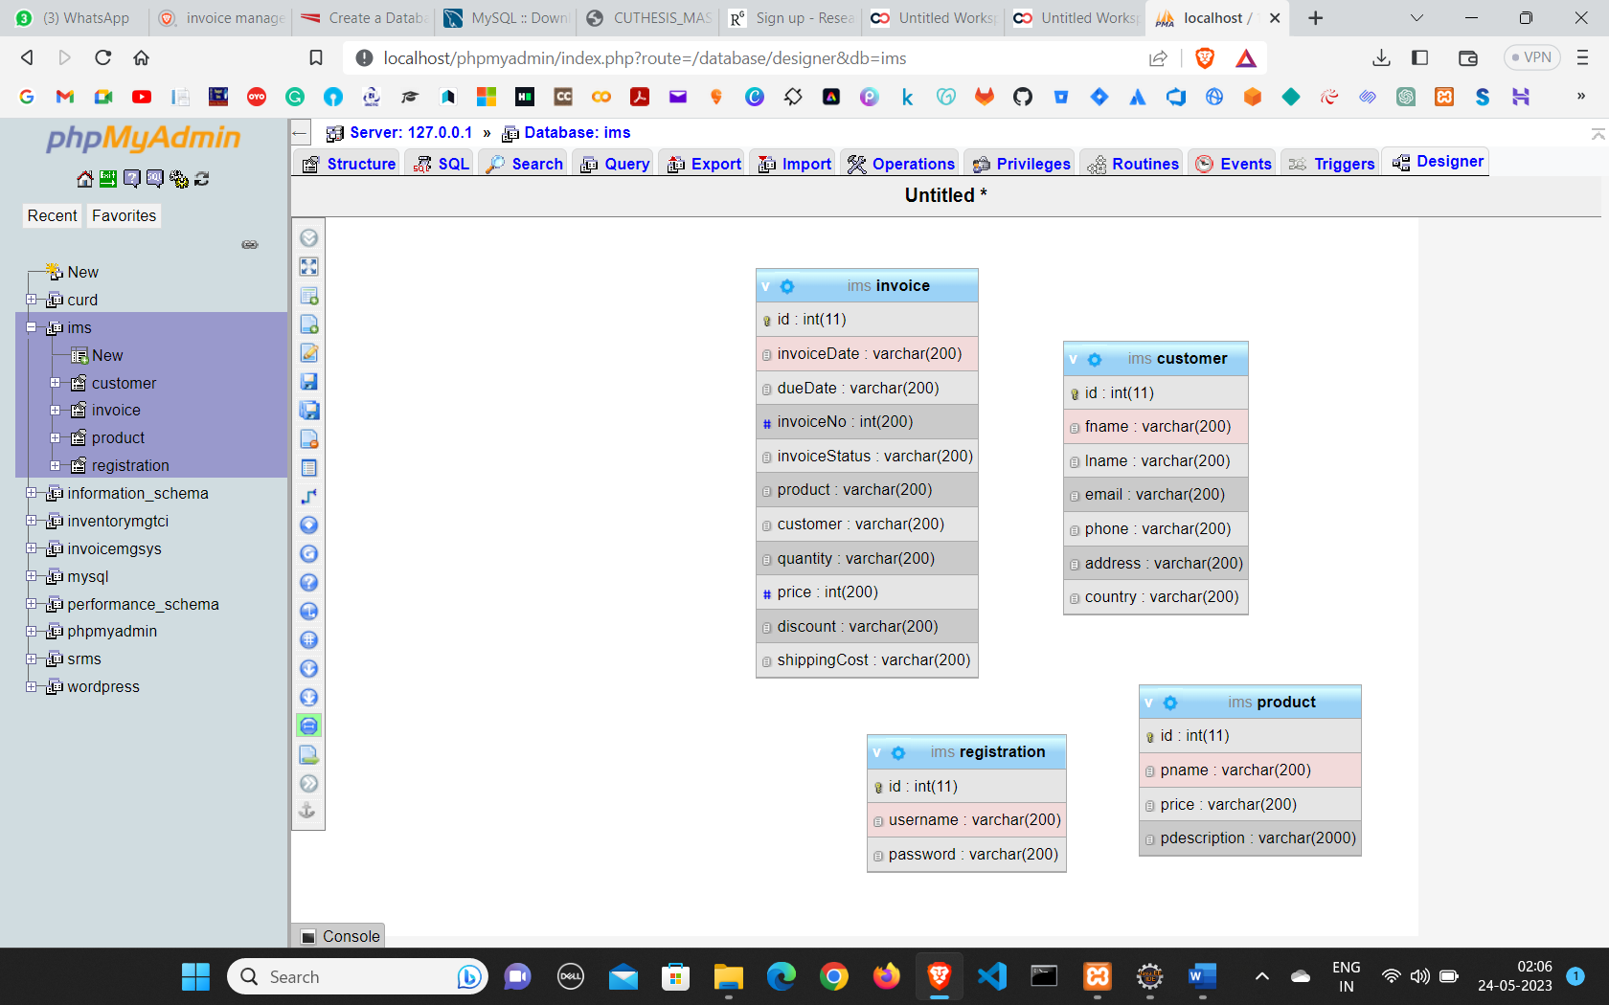
Database

Slide 25
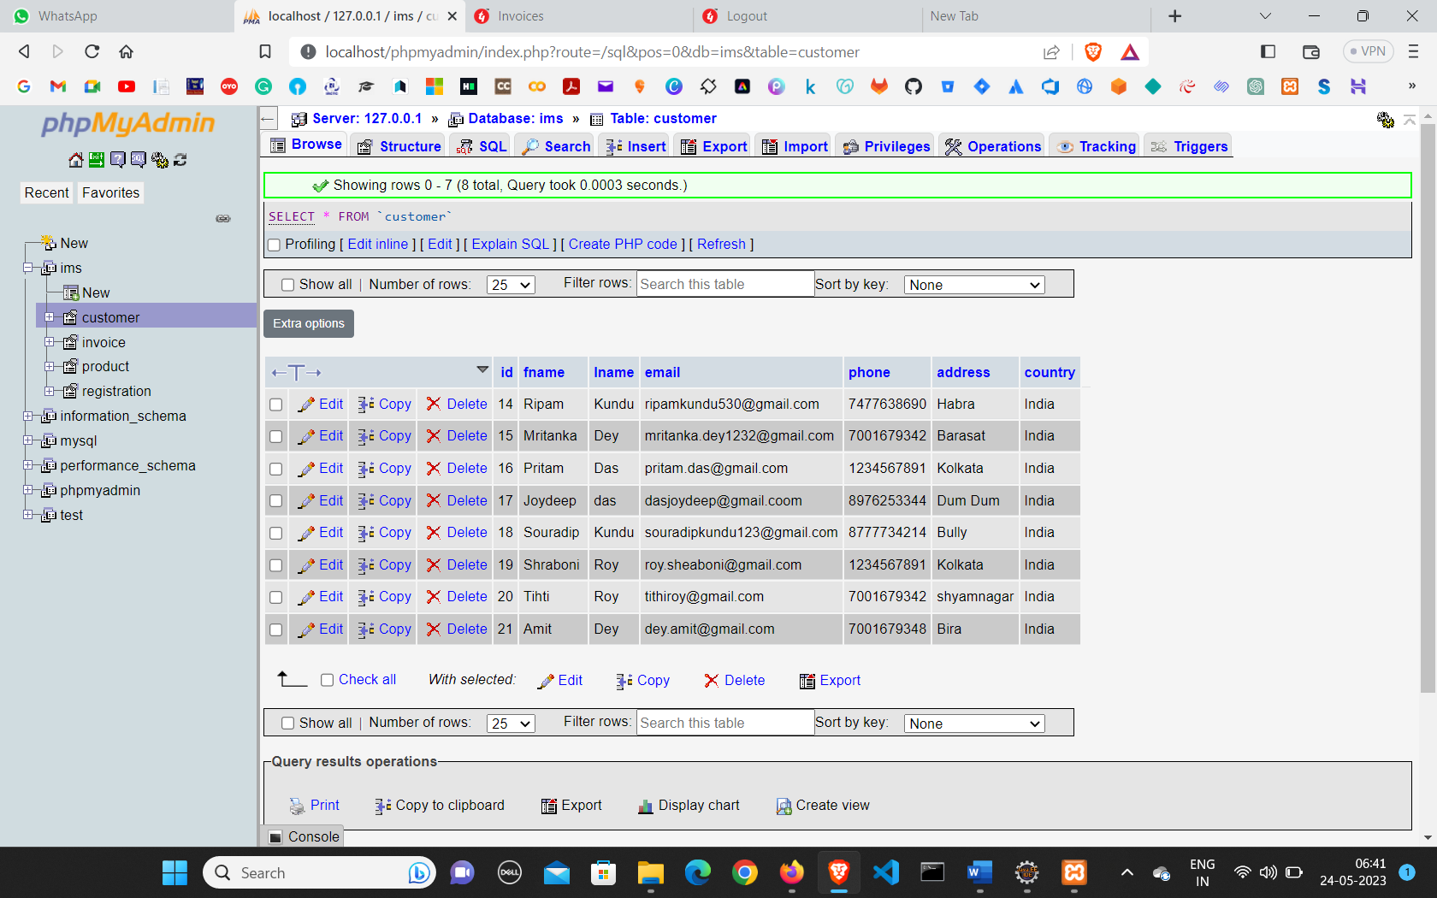
Customer Table

Slide 26

FUTURE SCOPE OF THE PROJECT
The future scope and further enhancement of an invoice management system can be quite extensive, as technology continues to evolve and businesses seek more efficient ways to manage their invoicing processes. Here are some potential areas of improvement and future developments for an invoice management system:
One of the key areas of enhancement would be increasing automation and integrating the invoice management system with other systems and software used by businesses. This could include integrating with accounting software, customer relationship management (CRM) systems, and enterprise resource planning (ERP) systems to streamline the entire invoicing process and eliminate manual data entry.
In future we would like to keep working on this project and make a new addition to provide users with more advanced features and more detailed information. We have set our sights on the following additions in future: -
Forget password for admin and councilor.
Online payment process through debit and credit card.
Auto mail will be sent to the user’s email-id when new user creates their ID.

Slide 27

Conclusion of the project
This project has been appreciated by all the user in the organization. It is easy to use, since it uses the GUI provided in the user dialog. User friendly screens are provided. The usage of software increases the efficiency, decrease the effort. It has been efficiently employed as a Site management mechanism. It has been thoroughly tested and implemented. Although I have put my best efforts to make the software flexible, easy to operate but limitations cannot be ruled out even by me. Though the software presents a broad range of options to its users some intricate options could not be covered into it; partly because of logistic and partly due to lack of sophistication. Paucity of time was also major constraint; thus, it was not possible to make the software foolproof and dynamic Lack of time also compelled me to ignore some part such as storing old result of the candidate etc. Considerable efforts have made the software easy to operate even for the people not related to the field of computers but it is acknowledged that a layman may find it a bit problematic at the first instance. The user is provided help at each step for his convenience in working with the software.

Slide 28

References
A listing of different sources that were used in designing , developing ,carrying out and understanding the development are :
www.nevonprojects.com
www.tutorialspoint.com
www.geeksforgeeks.org
www.w3schools.com
www.studentprojectguide.com
Class Notes
Invoice Management System

Slide 29

Thank you

